Slide 1

Cuboree
2026
INFORMATION SESSION
Baden-Powell Park, Samford
9 to 13 April 2026

Slide 2
Introducing the 8th Queensland Cuboree
8th Queensland Cuboree | Cuboree 2026
Baden-Powell Park, Samford
Theme
“Shake It Up”
Thursday 9 April to Monday 13 April 2026
Cost – Cub Scouts
$660
Cost – Service Leaders
$450
Applications are NOW OPEN
Applications close 15 November
Part time and Day Leader, available for 18+

Slide 3
What is a Cuboree?
A large gathering of Scouts. Jamborees are held all over the world.
The purpose of Cuboree is to provide young people with a fun, safe and engaging program that encourages participation, independence, and teamwork. Through a wide variety of activities and experiences, Cub Scouts grow in confidence and develop resilience, It’s a celebration of everything they’ve achieved so far in Scouting and a launchpad for the adventures still to come.
Cuboree 2026 will be the 8th Queensland Cuboree. It’s essentially a gigantic Cub Scout camp attended by around 1,000 people. Every Cuboree has its own theme, 2026 is ‘Shake it Up!’
Cuboree is an aged appropriate event for the Cub Scout section. Hundreds of adults attend as Cub Scout Leaders within units or Service Leaders that help run the Cuboree.

Slide 4
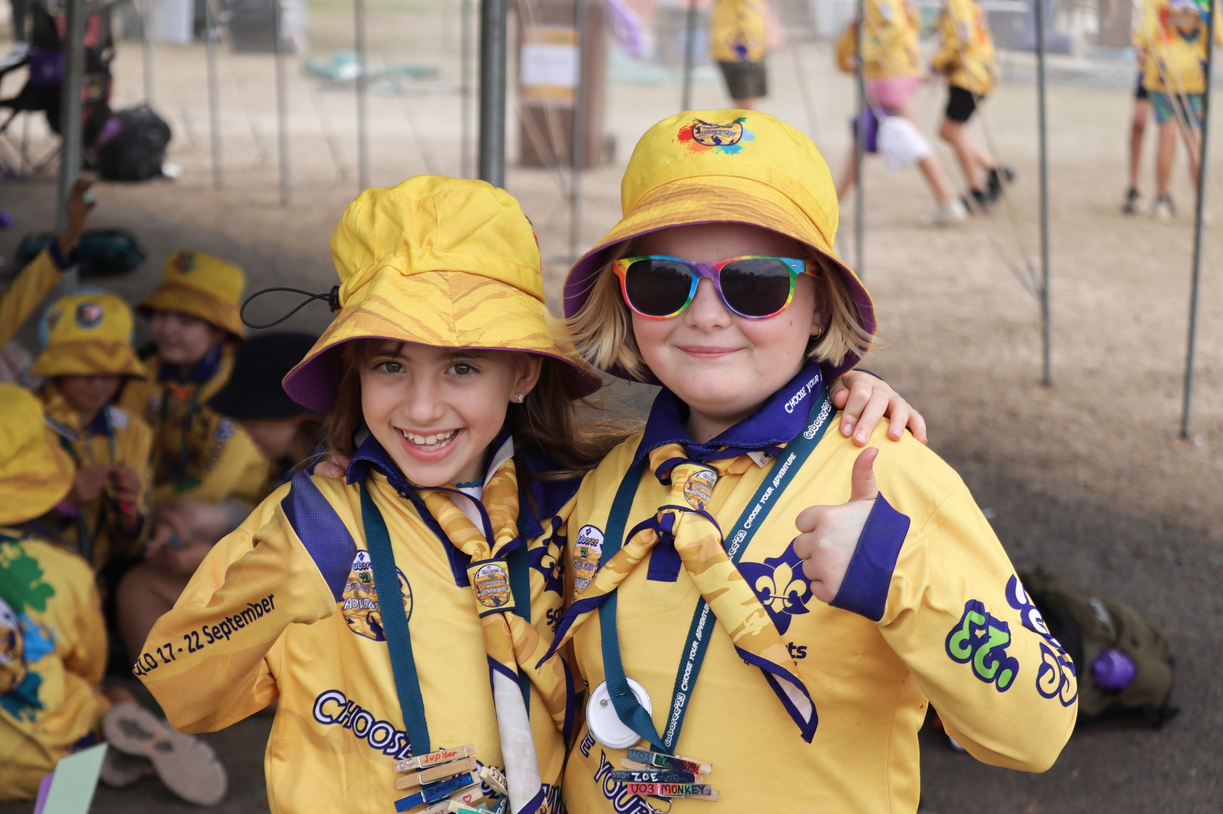
Why go to a Cuboree?
To encourage the physical, intellectual, social, emotional, and spiritual development of young people.
To increase resilience in young people.
A chance to make new friends from right across Queensland.
Participate in exciting activities, which include off-site activities in the surrounding areas of the campsite.
It will be one the most memorable and impactful experiences you have in Cub Scouts.

Slide 5
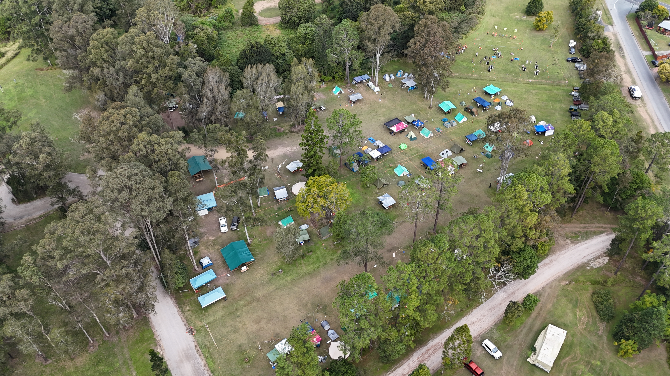
When and where is Cuboree 2026?
Cuboree is being held from 9 April to 13 April 2026 in Brisbane, Queensland at Baden-Powell Park in Samford Valley.
Baden-Powell Park is a dedicated purpose-built for Scouting, the site features dedicated activity zones, a swimming pool, walking trails, an abseiling tower, and plenty of space for camping, exploring and of course, Cuboree fun. It’s a space full of Scout history and adventures, perfect for Cub Scouts to come together, try new things, and make lifelong memories.

Slide 6

Building on the first 7 amazing Cuborees
2010
Cuboree 2010
'Web of Life’
2012
Cuboree 2012
'Magical Mystery Tour'
2014
Cuboree 2014
'Time of Legends'
2016
Cuboree 2016
'Rumble in the Jungle'
2018
Cuboree 2018
'Going Troppo'
2021
Cuboree 2021
'World Tour'
2023
Cuboree 2023
'Choose your Adventure'

Slide 7
t
Eligibility Requirements – Cub Scouts
Must be a current financial & registered member of Scouts Queensland.
Must be a current invested Cub Scout section member at the time and during Cuboree 2026.
Must be aged 8.5 to 11.5 years old at time and during Cuboree 2026.
Must have completed 4 nights camping under canvas as a Cub Scout with the Unit at a Cub Scout camp.
  Two of those nights must be consecutive. Sleeping in bunks/inside and camping with family or school is not considered for any of the nights.
Must have met the requirements, before 1 April 2026.
  Introduction to Cub Scout Section
  Program Essentials – Milestone 1
  Outdoor Adventure Skills – Camping Stage 2
Must be considered by their parents/guardians, Unit Council & Cub Scout Leaders to be of both sufficient maturity and good behaviour to successfully participate in the event.
Must have approval from the Unit Council & Cub Scout Leaders.
Must have consent from their parents/guardians.

Slide 8
t
Eligibility Requirements – Scouts
Must be a current financial & registered member of Scouts Queensland.
Must be a current invested Scout section member at the time and during Cuboree 2026.
Must be aged 13 years old or older at the time of Cuboree 2026.
Must have met the requirements, before 1 April 2026.
  Introduction to Scout Section
  Program Essentials – Milestone 2
  Outdoor Adventure Skills – Camping Stage 3
Must be considered by their parents/guardians, Unit Council & Scout Leaders to be of both sufficient maturity and good behaviour to successfully participate in the event.
Must have approval from the Unit Council & Scout Leaders.
Must have consent from their parents/guardians.

Slide 9
t
Eligibility Requirements – Venturer Scouts
Must be a current financial & registered member of Scouts Queensland.
Must be a current invested Venturer Scout section member at the time and during Cuboree 2026.
Must have met the requirements, before 1 April 2026.
  Introduction to Venturer Scout Section
  Program Essentials – Milestone 1
  Outdoor Adventure Skills – Camping Stage 3
Must be considered by their parents/guardians, Unit Council & Venturer Scout Leaders to be of both sufficient maturity and good behaviour to successfully participate in the event.
Must have approval from the Unit Council & Venturer Scout Leaders.
Must have consent from their parents/guardians.

Slide 10
t
Eligibility Requirements
Rover Scouts, adult Members and Leaders
Must be a current financial & registered member of Scouts Queensland.
Must be a current invested member at the time and during Cuboree 2026.
Must hold a current Queensland Working with Children Check (Blue Card).
Must have completed and current mandatory e-learning modules.
  WHS for Scouting, Child Safe Scouting and Adult Code of Conduct
Must be considered by their upline team leader (or Unit Council) to be of both sufficient maturity and good behaviour to successfully participate in the event.
Must have approval from the upline team leader (or Unit Council)
Please note: selection for certain roles will require the participant to hold a Wood Badge and/or Certificate of Appointment in their current role.

Slide 11
What will Cuboree Look Like for Cub Scouts?
Each Subcamp will have a team of 6 Subcamp Leaders.
A Cuboree Unit will have 36 Cub Scouts arranged in 6 Patrols of 6 Cub Scouts, as well as 6 Leaders
There will be 3 youth Subcamps for Cub Scouts.
In each Subcamp there will be 6 Cuboree Units.

Slide 12
What will Cuboree Look Like for Junior Service Leaders (Scouts and Venturer Scouts)?
The Subcamp will be led by 3 Junior Service Leaders selected by the Cuboree Executive, supported by 4 Subcamp Leaders
All meals will be eaten within the Dining Halls of the youth Subcamps, on a rotating schedule.
There will be a Subcamps for Junior Service Leaders.
Junior Service Leaders will be allocated a job based off their preferences. Same as adult Service Leaders.

Slide 13
What will Cuboree Look Like for Service Leaders (Rover Scouts, adult Members & Leaders)?
The Subcamp will be led and managed by the Camping Team. All meals will be within the Dining Halls of the youth Subcamps
A Service Leader could be Full Time, Day Worker or Residential Part Time.
There will be a Subcamps for Service Leaders.
Service Leaders will be allocated a job based off their preferences.

Slide 14
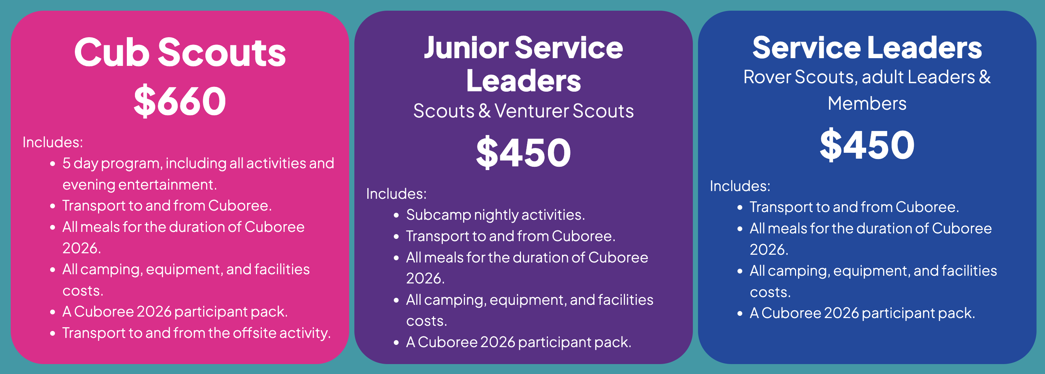
What is the cost and inclusions for Cuboree?

Slide 15
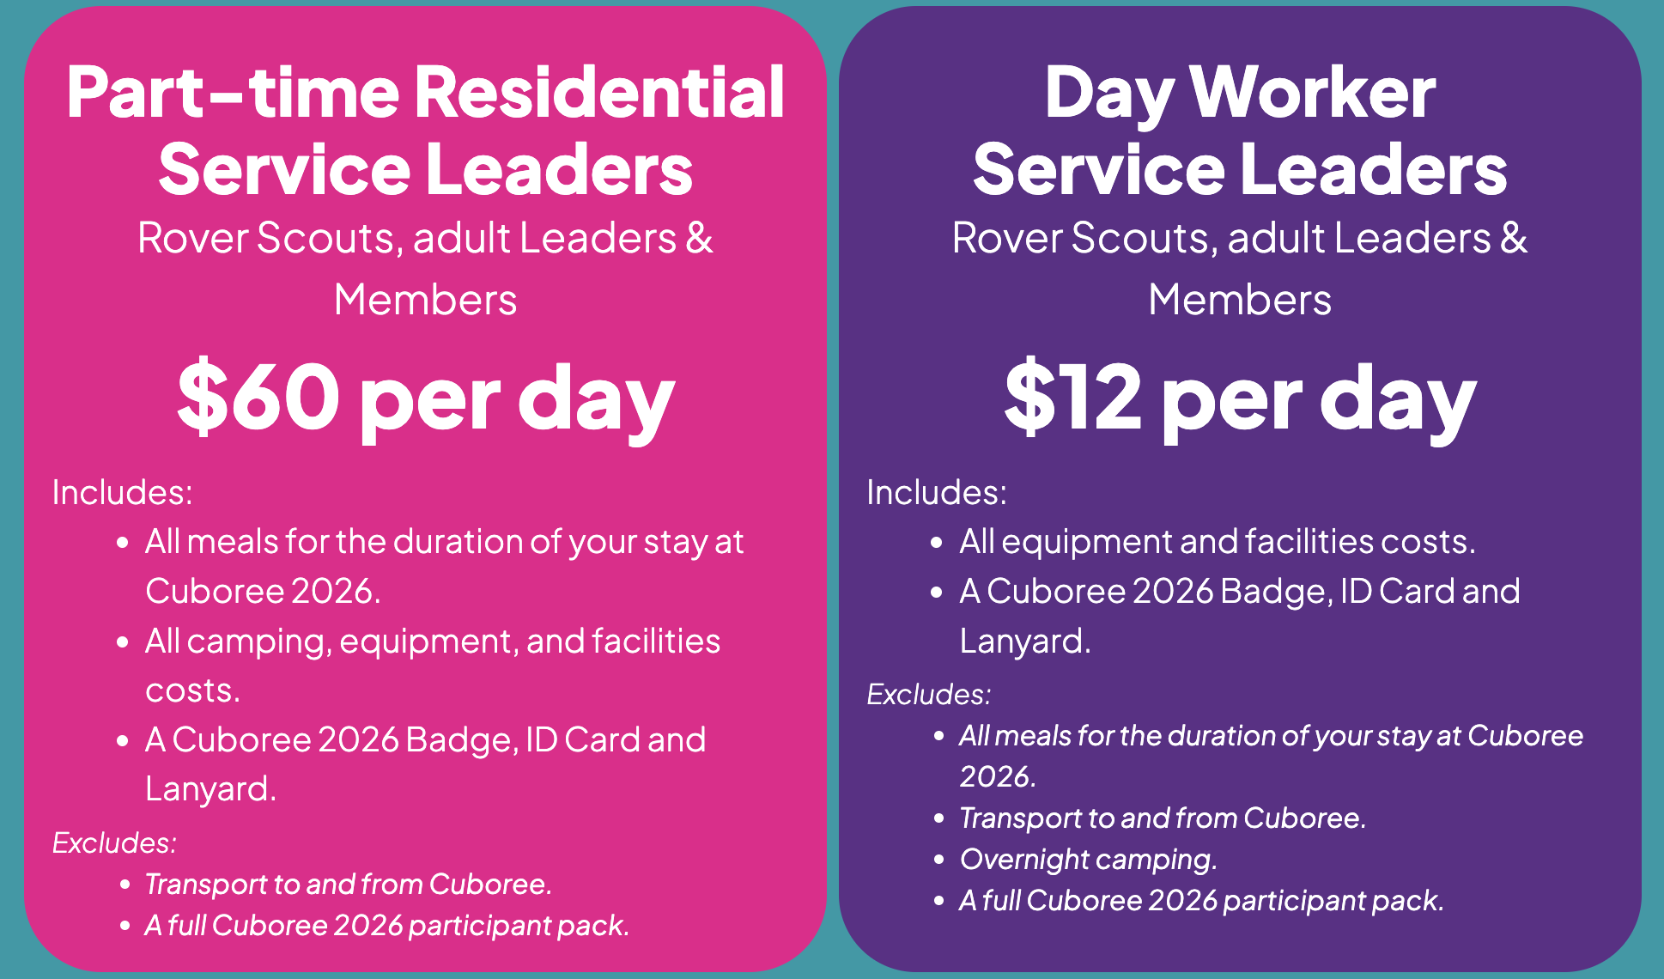
What is the cost and inclusions for Cuboree?
Applications for these type of Service Leaders will open shortly.

Slide 16
Camp Fee Payment Schedule
More information available & payment plans at cuboree.scoutsqld.com.au/camp-fees
Payment | Due Date | Cub Scouts | Service Leader
Payment 1 (Deposit) | On Submission of Application | $60 | $40
Payment 2 | 30 September 2025 | $175 | $110
Payment 3 | 31 October 2025 | $175 | $110
Payment 4 | 30 November 2025 | $150 | $110
Payment 5 | 15 February 2026 | $100 | $80
Total |  | $660 | $450

Slide 17
Program
Day 1 is filled with traveling, setting up our camp, meeting new people and settling in. But the day is not over when the sun goes down, we will have an evening activity, a Cuboree Opening.
Day 2, 3 and 4 are Program activity days and even entertainment
Day 5 is pack up, exchange contact details with our new friends, Goodbyes and travel home.

Slide 18
Program
Get ready for a Cuboree experience like no other, we're shaking things up and bringing even more
excitement to your adventure!
A full day of action across our adventurous zones. From scaling heights in the vertical arena, making a splash in aquatic activities, to challenges on solid ground, there's something for every Cub Scout to enjoy.
Experience a hands-on day of discovery and creativity. Cub Scouts will explore science, technology,
engineering, the arts and more through interactive and engaging activities designed to inspire curious minds.
This year, we’re offering something new, a preference between two offsite adventures. Cub Scouts can choose to spend the day by the sea or take to the skies for a completely
different kind of thrill. Submit your preference on your application.
More information about these exciting days is coming soon.
Get ready to ‘Shake It Up!’ at Cuboree 2026!

Slide 19
Transport & Travel
Transport to and from Cuboree is included in your camp fees. More details surrounding your travel details will be provided in 2026 closer to Cuboree. All buses will leave from Hubs within your Regions and Districts (depending on numbers).
We are working on options which include using trains for long distance participants. Everyone will arrive onsite by a bus There will be no independent travellers allowed to Cuboree 2026. If you travelling independently, you will be asked to meet at a offsite location to catch a bus onto site.
If you have any questions surrounding transport and travel please contact Cuboree at info@cuboree.scoutsqld.com.au.

Slide 20
Health & Wellbeing
The Health and Wellbeing directorate has 3 specialty teams within it. The first point of call is always your Unit Leaders and Subcamp team. The more we know before Cuboree and during if something arises the more our teams will be able to assist. Taking breaks is important for everyone.
We have a great team of professionals volunteering their time to support Cuboree.
Health & Wellbeing
Wellbeing
First Aid
Medical

Slide 21
How are we ‘Shaking It Up!’?
If you have been to a Cuboree before, we are shaking it up and bringing in some new changes for 2026 and beyond.
Cuboree 2026 will be held in Autumn school holidays.
  This shift from pervious Cuborees, allows for no overlap of Major Events, greater access to facilities and equipment. As well allowing Leaders to attend who could not previously.
Cuboree is moving to a 3 year cycle. The 9th Queensland Cuboree will be in 2029.
Cuboree 2026 will be 5 days and 4 nights.
  This aligns Queensland Cuboree with other states, and half the time of a Jamboree.
  There will be 3 activity days.
In 2026 there will be 3 youth Subcamps.
This Cuboree, we’re offering something new, a preference between two offsite
adventures. Cub Scouts can choose to spend the day by the sea or take to the skies
for a completely different kind of thrill.

Slide 22
How are we ‘Shaking It Up!’?
Core Scouting Skills will be at the heart of everything we do, from Hygiene to Camping and Resilience.
  All participants, including Cub Scouts will be doing their own dishes after meals, washing hands at every entry point to campsites and activities.
  A Cub Scout appropriate Camping Standard is being developed based off the Scout Section one to be implemented at Cuboree. More information will be shared soon to help Units prepare.
  Cub Scouts will have independence whilst following the Youth Leading, Adult Supporting Framework.
  This will also assist in their transition into the Scout Section.
Meal times will be within their own Subcamp, with Service Leaders rotating between the three youth Subcamps for meal times.
  More time to enjoy your meal and talk to your new friends.
  Plate, Bowls and Cutlery will be provided for each meal, and washed up by the participants.

Slide 23
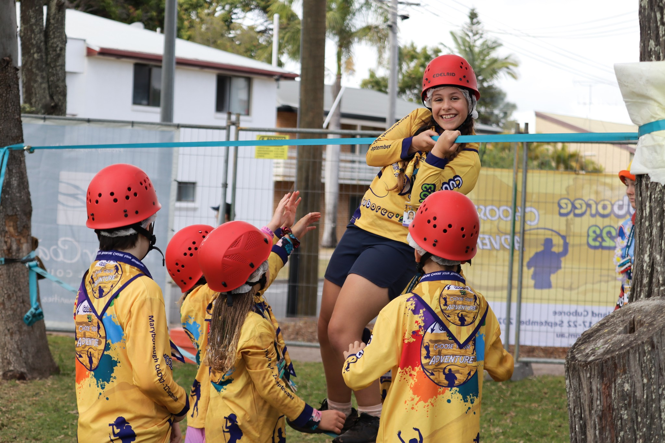
What to do now?
Go to the website and register to attend the Cuboree - cuboree.scoutsqld.com.au
Read the Cuboree Newsletter 1 available on the website – cuboree.scoutsqld.com.au/news
Start brainstorming fundraising ideas to help pay for the Cuboree
Begin your preparation for the Cuboree. Start planning camps and identify what program achievements you need to complete before April 2026.
Speak to other youth members or adults who have attended a past Cuboree.

